Slide 1

DARK WEB
A
SEMINAR
Submitted to
JAWAHARLAL NEHRU TECHNOLOGICAL UNIVERSITY
HYDERABAD (T.S)
In partial fulfillment of the requirements for the award of the degree of
BACHELOR OF TECHNOLOGY
IN
COMPUTER SCIENCE AND ENGINEERING
By
PANS PREETHAM ARUN 15641A05K7
VAAGDEVI COLLEGE OF ENGINEERING
(UGC Autonomous, Permanent Affiliation to JNTU, Hyderabad & Accredited by NBA)
BOLLIKUNTA, WARANGAL-506005(T.S)
2018-2019

Slide 2
THE DARK WEB
Anonymity on the Internet
By
PANS PREETHAM ARUN

Slide 3
TABLE OF CONTENTS
01. UNDERSTANDING DARKWEB
02. ONION ROUTING
INTERNET AND WEB
WHAT IS TOR?
DARKNET
HOW TOR WORKS?
SURFACE WEB, DEEP WEB, DARK WEB
ENCRYPTION IN TOR
02. HIDDEN SERVICES
TOR HIDDEN SERVICES
HOW TO STAY ANONYMOUS ON THE INTERNET

Slide 4
01
DARKWEB
INTERNET AND WEB
DARKNET
SURFACE WEB, DEEP WEB, DARK WEB

Slide 5
INTERNET VS WEB
INTERNET ( Physical connection of all computers joined together across the world)
WEB ( The software that runs on the physical internet )

Slide 6




DARKNET
OVERLAY NETWORK
Network build over a network Is An Overlay Network
INTERNET
(Surface web)
SOURCE
DESTINATION
Overlay Network That uses Onion Routing is Called DARKNET
Tor is a Darknet that uses onion Routing Technology
There Are Also other Darknets

Slide 7

Surface web vs Deep web vs Dark web
Surface web
Google, Youtube, College website, ETC.
Anything accessible directly through a Search engine
Deep web
Private Emails/FB accounts, Private Databases.
Anything You can’t access with a google search or has security
Need Special Software to Access
Dark web
Markets, TOR Sites , Hidden Services.
Purposefully hidden, Special access material.

Slide 8
Surface web vs Deep web vs Dark web
DEEP WEB
SURFACE WEB, CLEARNET
-2%
- 98%
DARK WEB. TOR HIDEEN DERVICES, DARKNET
- 0.03%

Slide 9






Surface web vs Deep web vs Dark web
(DARKNET)

Slide 10
02
ONION ROUTING
HISTORY OF TOR
HOW TOR WORKS
ENCRYPTION IN TOR

Slide 11
TOR
Short form for (THE ONION ROUTER)
Tor is a free software for enabling anonymous bidirectional communication
Tor uses Onion routing to encrypt and sent information over the internet
Tor directs Internet traffic through a free, worldwide, volunteer Network Consisting of more than 7,000 relays (Nodes)
Tor does not hide the fact that you are using Tor
Tor uses TCP ( Transmission control protocol )
Instead of .com, .org, .in, .net Tor uses .onion (http://3g2upl4pq6ku4m.onion)

Slide 12

HISTORY OF TOR
The idea of “Onion Routing” was created
By U.S. Naval Research Laboratory in
Mid-1990s
First version of Tor was developed
On September 22, 2002
Tor project was
Created on
December 2006
1990
2000
2010
Onion Routing was Further Developed
By DARPA in 1997
Tor code was released
Under free license
Aug. 13, 2004

Slide 13
HOW INFORMATION IS SENT OVER THE INTERNET?
SOURCE A
DESTINATION B
Information is not sent as a whole
It is sent piece by piece and then reassembled

Slide 14
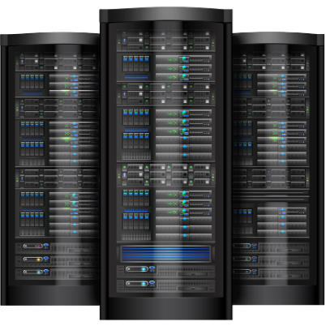

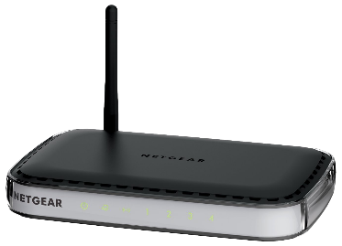
HOW YOU CONNECT TO THE INTERNET ?
Modem
Your Computer
Internet Service provider (ISP)
Eg. Asianet, BSNL

Slide 15


NORMAL CONNECTION TO THE INTERNET
HACKER/SPY
ISP knows who you are
Which website you are browsing
What Information is being shared
Modem
Your Computer
Internet Service provider (ISP)
Eg. Asianet, BSNL

Slide 16

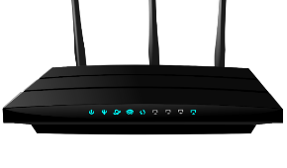

How Tor Works?
Your Computer
Tor Network
Web Service
Guard/Entry Node
Middle Node
Exit Node
Secure Connection
Not Secure

Slide 17
Encryption & Decryption
KEY
=
ENCRYPTION
MESSEAGE
DECRYPTION
=
CIPHER

Slide 18
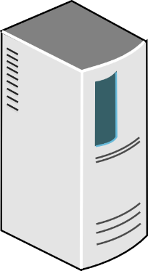
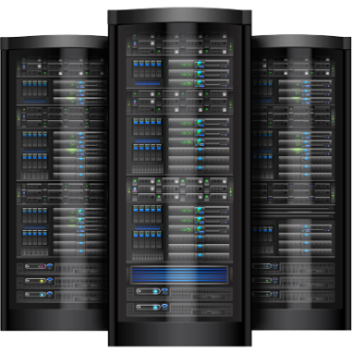
How Tor Works ?
Middle Node
Exit Node
Web Service
Guard/Entry Node
3.3.3.3
4.4.4.4
2.2.2.2
5.5.5.5
1.1.1.1
Your Computer
A
B
C
KEY NEGOTIATION
Diffie Hellman Key Exchange Protocol
Public Key Encryption

Slide 19

How Tor Works?
Middle Node
Exit Node
Web Service
Guard/Entry Node
3.3.3.3
4.4.4.4
2.2.2.2
5.5.5.5
1.1.1.1
Your Computer
A
B
C
DATA
SEND TO 3.3.3.3
SEND TO 3.3.3.3
SEND TO 4.4.4.4
SEND TO 4.4.4.4
SEND TO 4.4.4.4
SEND TO 5.5.5.5
SEND TO 5.5.5.5
SEND TO 5.5.5.5
SEND TO 5.5.5.5
ONION ROUTER(Layers of encryption)
DATA
DATA
DATA
DATA
DATA

Slide 20
How Tor Works?
Middle Node
Exit Node
Web Service
Guard/Entry Node
2.2.2.2
3.3.3.3
4.4.4.4
5.5.5.5
1.1.1.1
Your Computer
A
B
C
DATA
DATA
DATA
DATA
DATA
DATA

Slide 21
How Tor Works?
Middle Node
Exit Node
Web Service
Guard/Entry Node
2.2.2.2
3.3.3.3
4.4.4.4
5.5.5.5
1.1.1.1
Your Computer
A
B
C
512 bytes
512 bytes
512 bytes
DATA
DATA
DATA
All the Packets on the Tor network (cells) are of same size (512 bytes)

Slide 22
03
HIDDEN SERVICES
TOR HIDDEN SERVICES
HOW TO STAY ANONYMOUS

Slide 23
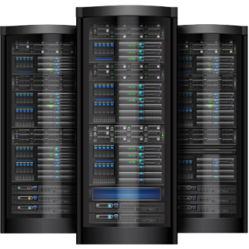




How Tor Works?
Dark Web Service
You
TOR NETWORK
DATA RATE
DATA RATE
After some time

Slide 24
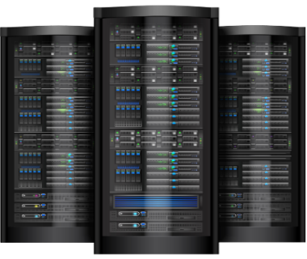
TOR Hidden Service Protocol
ONION SERVICE DESCRIPTOR
DB
IP’s
KEY
IP-1
Dark Web Service
RP
OTP
IP-2
IP’s
Alice
OTP
KEY
RP
IP-3
Tor Network

Slide 25


Precautions To Take While Browsing DARKNET
Don’t download anything from the darkweb (malicious files)
Don’t give away any kind of information related to identity
If you send personal information then use PGP(Pretty Good Privacy)
Keep Tor and OS up to date
Don’t use flash or javascript (Disable)
Don’t buy anything with your own credit cards Use Bitcoins
( Cryptographic Currency ) which is not traceable
Use TAILS (OS) instead of Windows

Slide 26
TAILS ( The Amnesic Incognito Live System )
TAILS is a Open source Linux Distribution
It is funded by the tor project
It forces all of its Incoming and Outgoing connection
to go through TOR
It is designed to be booted as Live DVD/USB
hence no digital footprint on is left on the system
It comes bundled with
ELECTRUM (BITCOIN WALLET)
THUNDERBIRD (email client) with Enigmail (OPEN PGP encryption)

Slide 27
Example for Hidden services
Literature ( Access to books banned in the country)
Used by Whistle-Blowers
By government to transfer sensitive information
Allows Normal users to browse internet safely
Facebook operates a hidden service

Slide 28
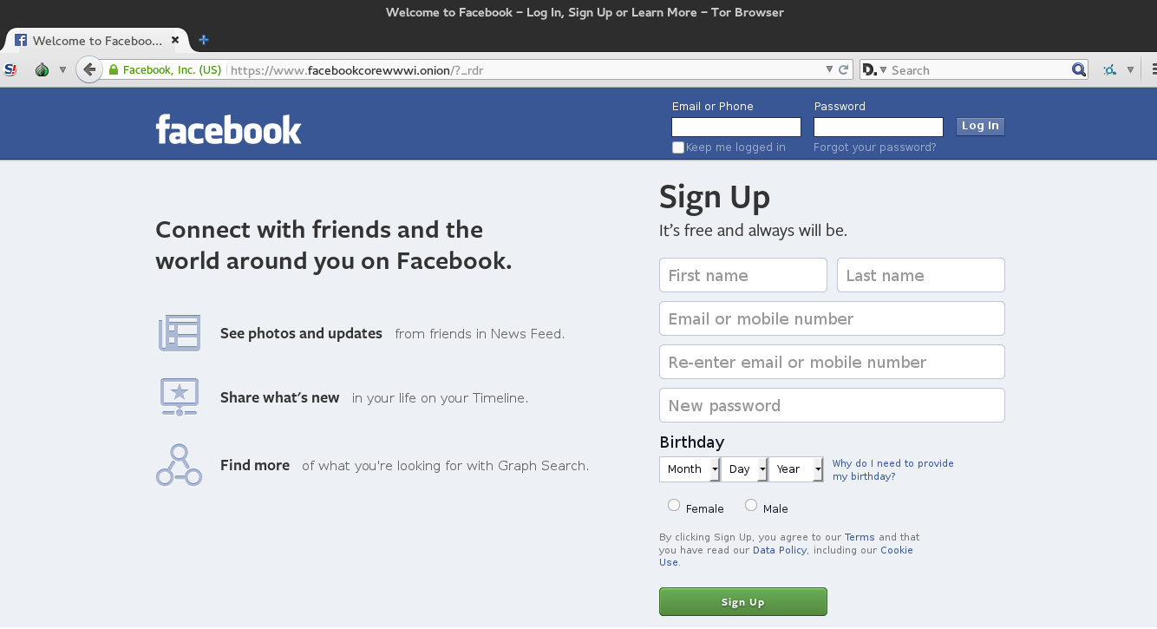

Slide 29
Example for Hidden services
Literature ( Access to books banned in the country)
Used by Whistle-Blowers
By government to transfer sensitive information
Allows Normal users to browse internet safely
Facebook operates a hidden service
Stolen credit card details
Illegal arms dealing
Human Trafficking
Hire a Hitman
Drugs ( Silk Road )
Other illegal activities

Slide 30
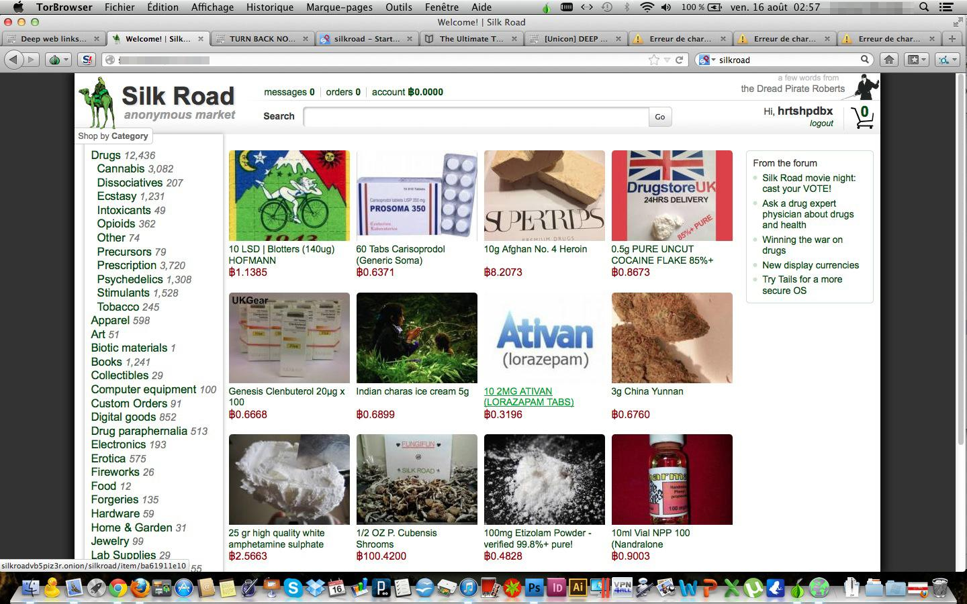

Slide 31
Conclusion
Dark web and Deep web are different
Tor can be used to browse normal internet to protect privacy
Anyone can create a hidden service and claim anything
Only browse the dark web after understanding it
Very dangerous because you can get involved in illegal activities willingly
Or unwillingly
Browsing the DARKWEB is not legal or illegal in India
Why don’t Law enforcement take down the entire Darkweb?
A govt. agent working undercover need Anonymity as much as terrorist
Or a drug dealer
“It’s either for everyone or no one”

Slide 32
THANK YOU

